Slide 1
UiPath Test Suite

Slide 2
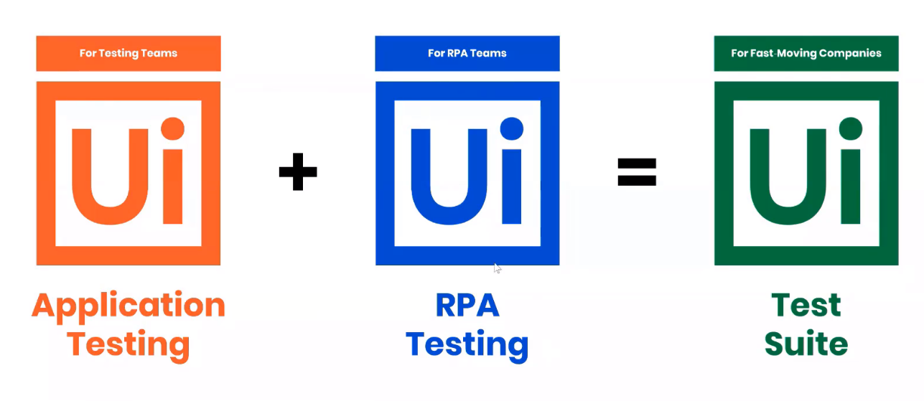
What is UiPath Test Suite?
UiPath Test Suite is a solution that serves for Application Testing and RPA Testing. UiPath Test Suite can be used across the stages (Functional , Regression) of the testing process.
The UiPath Test Suite is built to cover the end-to-end (and continuous) software testing process.
Application testing can be performed with Test Cases and Data Driven Test Cases, sequences that make use of verification activities part of the UiPath.Testing.Activities pack, together with activities from other packages.
RPA Testing is designed for testing workflows directly and viewing the activity coverage during execution. Such testing processes ensure that execution is performed and all corner cases are covered, regardless of the decisions taken during execution.

Slide 3
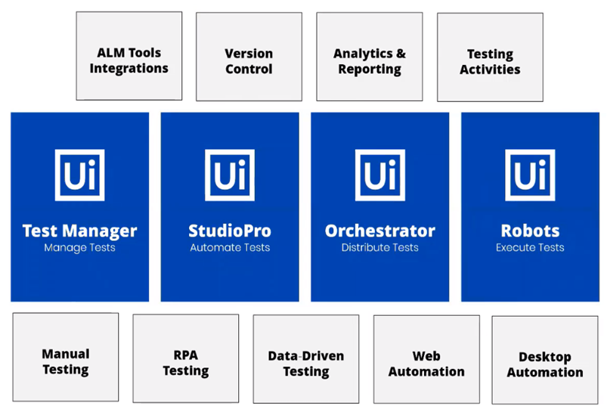
UiPath Test Suite is an umbrella constituting of Test Manager, StudioPro, Orchestrator and Robots. These serves for:

Slide 4
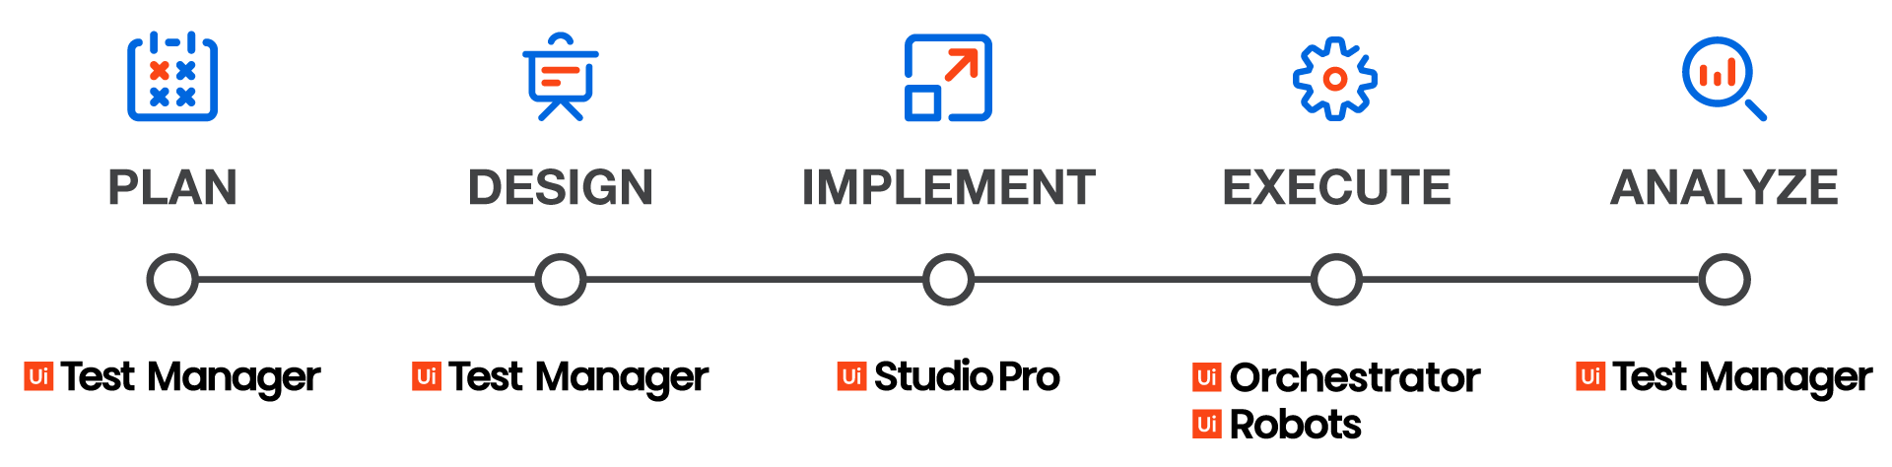
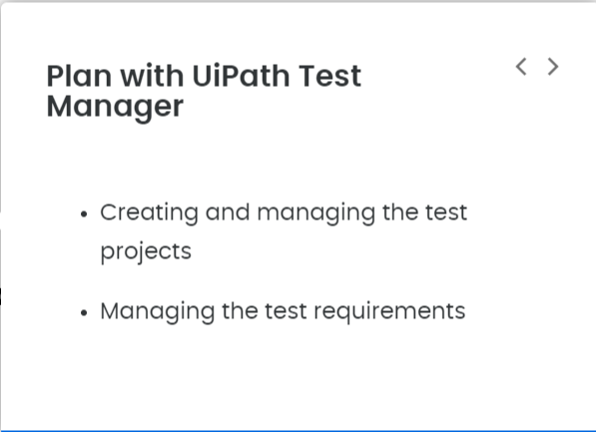
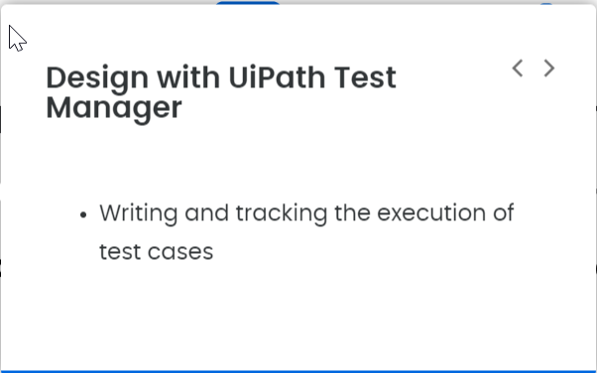
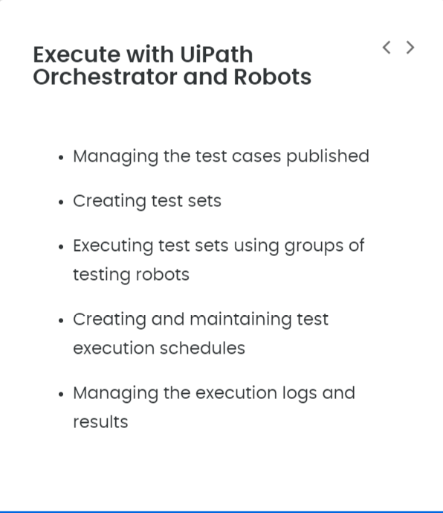
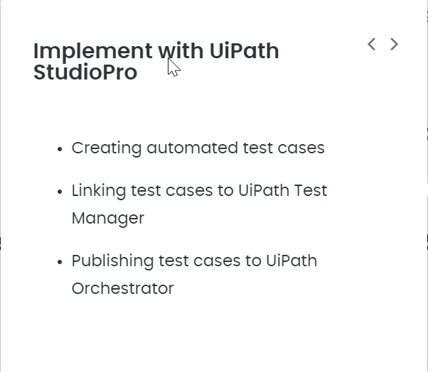
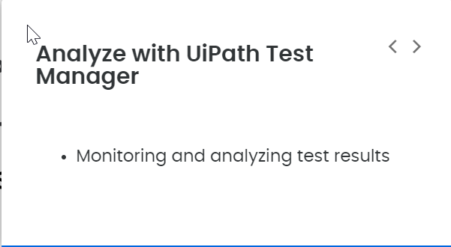
Each of the components has the main role in one stage:

Slide 5

The main value of the UiPath Test Suite solution relies in the synergies between the components, as well as the integration with the most popular tools in software development. To name a few:
Jira - UiPath Test Manager is able to pull the requirements from Jira as test requirements;
Git - UiPath StudioPro integrates with Git for version control management;

Slide 6
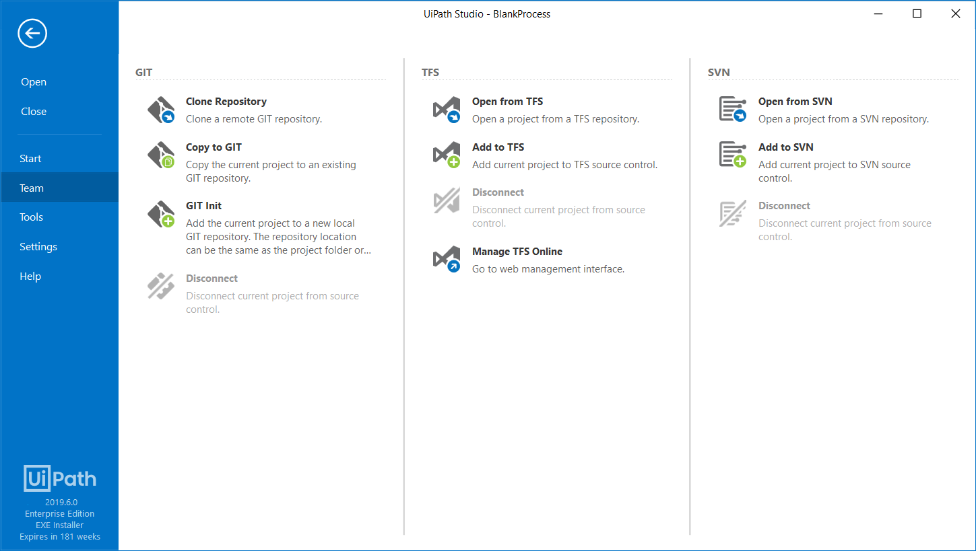

Slide 7
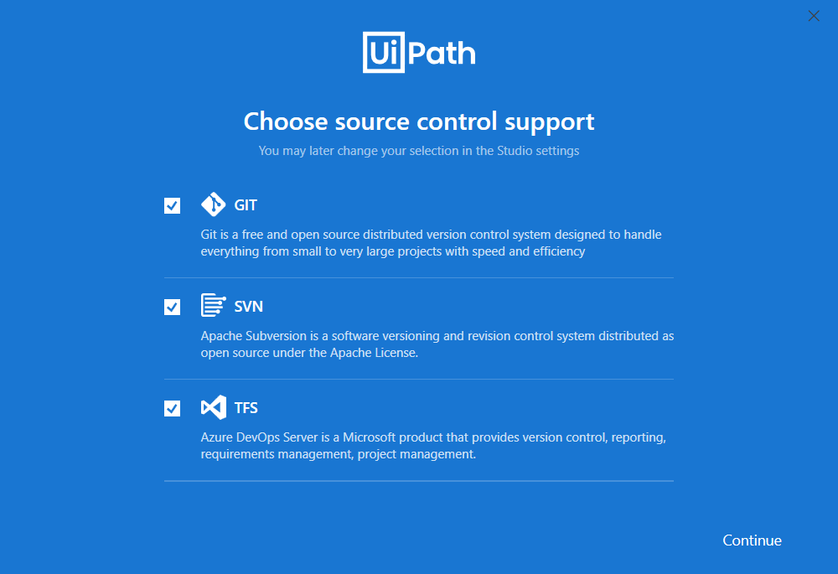

Slide 8
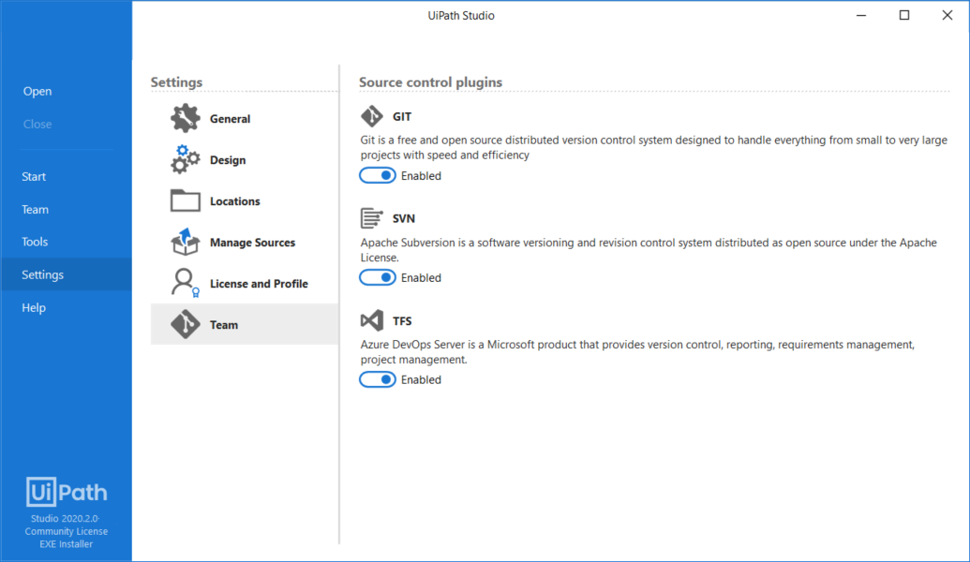

Slide 9
UiPath Test Suite Components
UiPath Test Manager
UiPath Test Manager is web-based interface expedites comprehensive test planning, requirements traceability, and defect reporting. It is simple to use and integrates with Atlassian Jira software.
UiPath Test Manager allows comprehensive management of testing process by addressing the following functional areas:
Assigning automation from StudioPro to test cases.
Assign test cases to requirements.
Dashboards to get a quick overview of your test results.
Reporting
Manual testing
Creating defects from test results

Slide 10
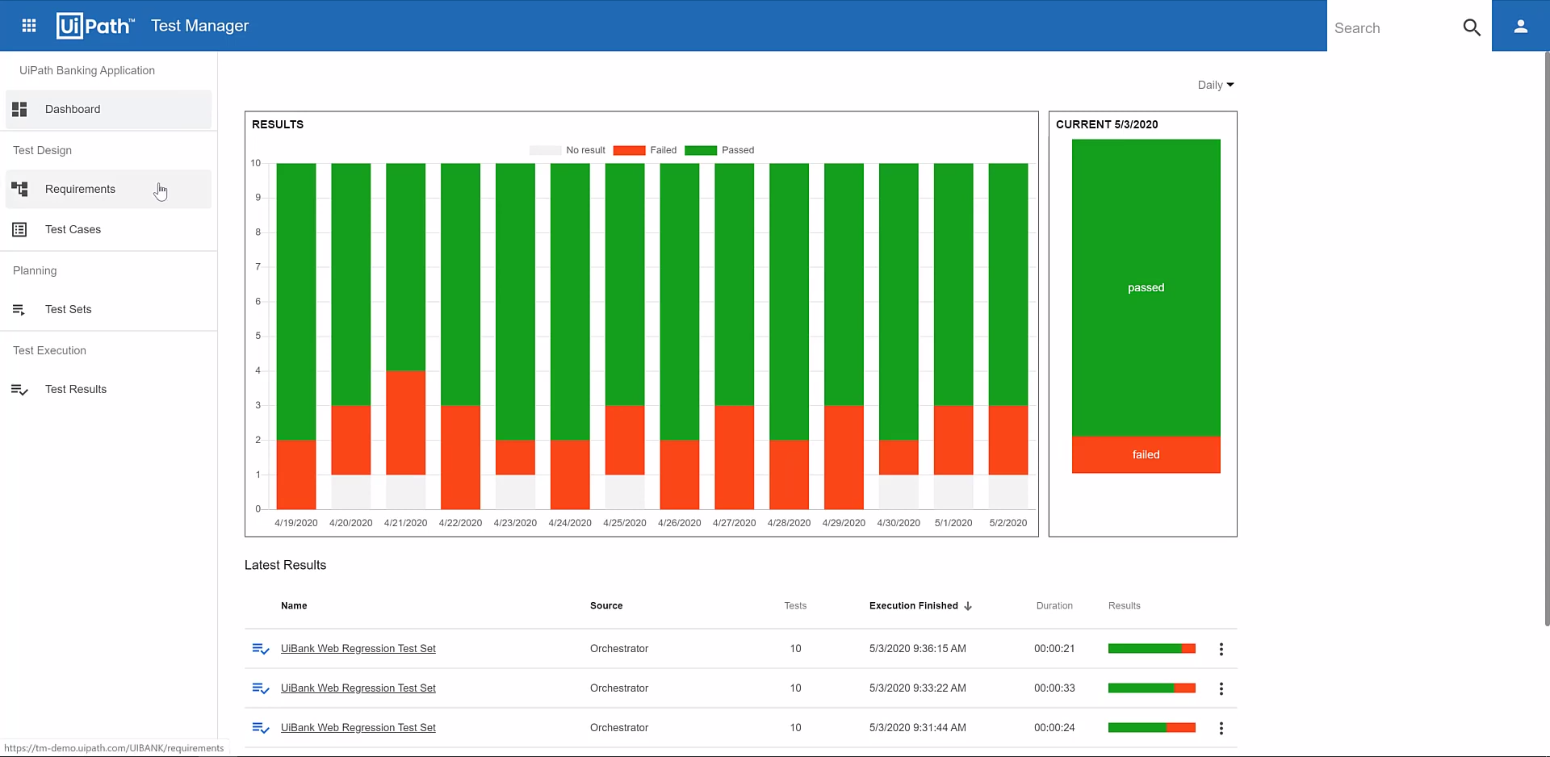

Slide 11
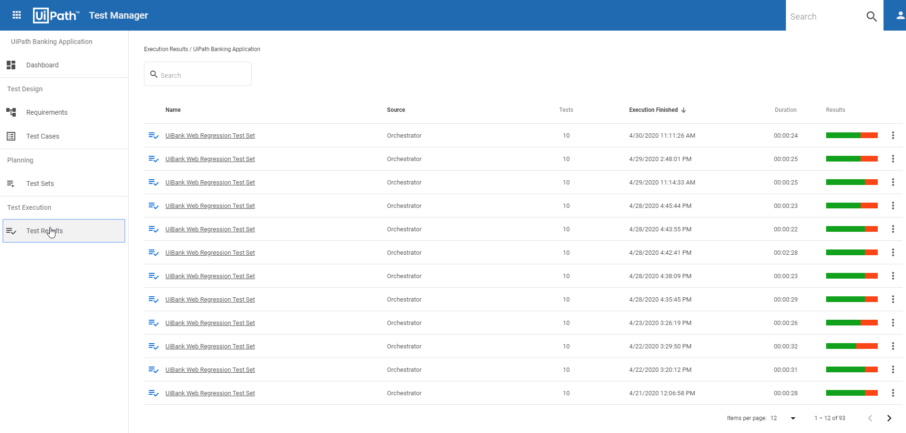
UiPath Test Manager provides a go-to place for analysing test results.
Finding test results even if they are from manual executions or automatic ones from Orchestrator.
Progress from running executions.
Analyzing details from results like logs and screenshots.
creating defects in your defect management system directly from Test Manager.

Slide 12
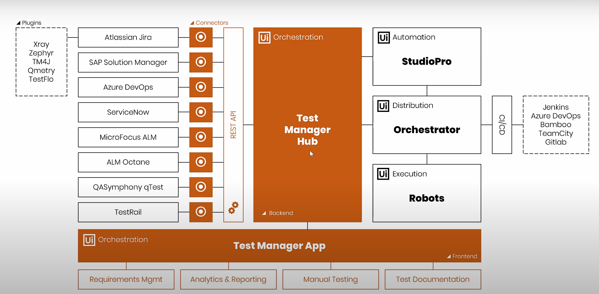
UiPath Test Suite Enterprise license is required to have access to own UiPath Test Manager. It's the component of the UiPath Test Suite used for managing test projects and test requirements, referencing test cases and handling the execution of manual testing. Another important function is managing test results for supporting the decision process.
UiPath Test Manager consists of the web application and the hub or server. The server integrates directly with UiPath StudioPro and UiPath Orchestrator and can be integrated with third party Application Lifecycle Management (ALM) tools, such as Jira.

Slide 13

UiPath StudioPro
UiPath StudioPro is a superset of UiPath Studio with a direct integration with UiPath Test Manager and specific capabilities for automating software testing. StudioPro is part of the same build as Studio and StudioX. There are two ways to set it up:
Through the Enterprise licensing model, if your company grants access to the UiPath StudioPro features;
Through the Community licensing model. Make sure you install the latest version of UiPath Studio community edition for this.
Few salient features specific to UiPath StudioPro:
A new Test Automation Project can be created exclusively supporting Test Cases/Data Driven test cases.
Instead of publishing whole project , individual set of test cases can be published to orchestrator using Publish as Test Cases option.
Integration with UiPath Test Manager serving Test management.

Slide 14
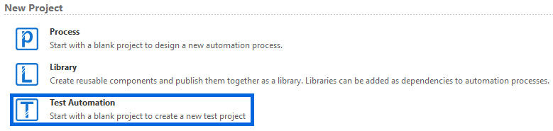
Following are some new feature pertaining to UiPath Studio Pro – Test Suite:
Specific Project Type:
A new type of project called Test Automation is now available to start with. It will automatically add the Test Activities Package and a Test Case workflow.

Slide 15
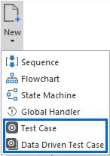
Specific Workflow Types:
Two new workflow types are available in StudioPro:
Test Case - a template for one simple test automation;
Data Driven Test Case - a template taking the input data from an Excel file.

Slide 16
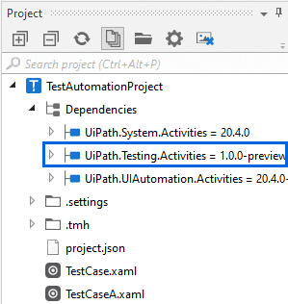
Specific Testing Activities:
Testing (Verification) activities were added through the UiPath.Testing.Activities package. The first version comes with these 3 activities:
Verify Expression
Verify Expression with Operator
Verify Control Attribute

Slide 17
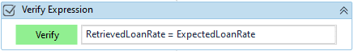
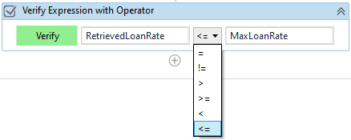
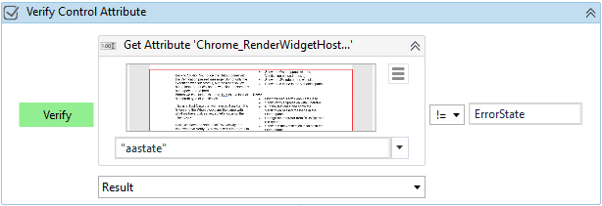
Verify Expression
This activity verifies a single expression
(e.g. whether two variables are equal). Its outcome can be True or False.
Verify Expression with Operator
This activity compares the outcomes of two expressions, variables or
arguments using 6 predefined operators. Its outcome can also be
True or False.
Verify Control Attribute
This is the most versatile activity in the first version of the
Testing Activities Package. It allows the comparison of a property returned
by another Activity with an expression, variable or argument.
Its outcome is can also be True or False.

Slide 18
UiPath Orchestrator
There are two ways to set it up:
Through the Enterprise licensing model and an on-premises instance of UiPath Orchestrator, if your company grants access to the UiPath Test Suite features;
Through the Community licensing model. Visit the UiPath Forum link below for more details.
UiPath Robots
There are two ways to set it up:
Through the Enterprise licensing model and an on-premises instance of UiPath Orchestrator, if your company grants access to UiPath Testing Robots;
Through the Community licensing model. You will need to set up at least one robot of type ‘Testing’. See the Testing Capabilities in Orchestrator Forum post above for more details.

Slide 19
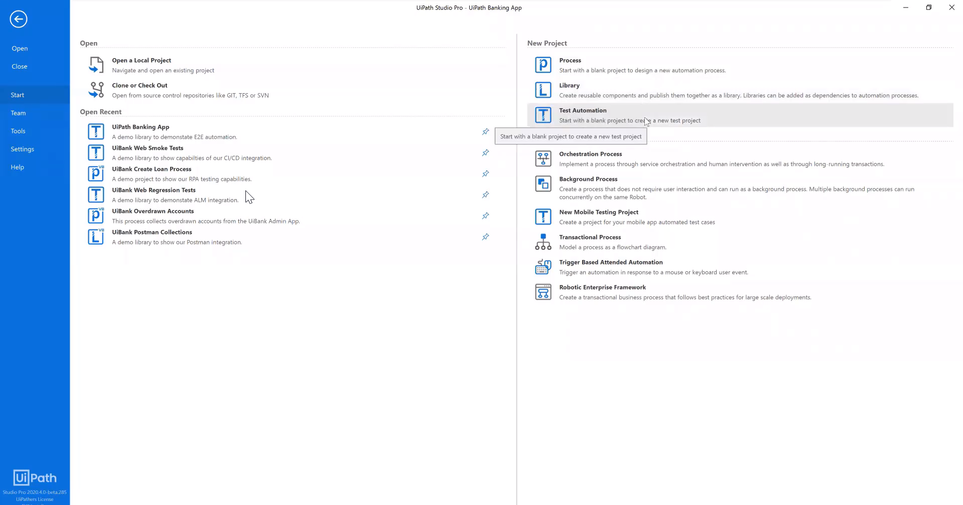
Studio Pro Test Cases/Data Driven Test Cases creation/maintenance under UiPath Studio Pro
A new Test Automation project can be created.

Slide 20
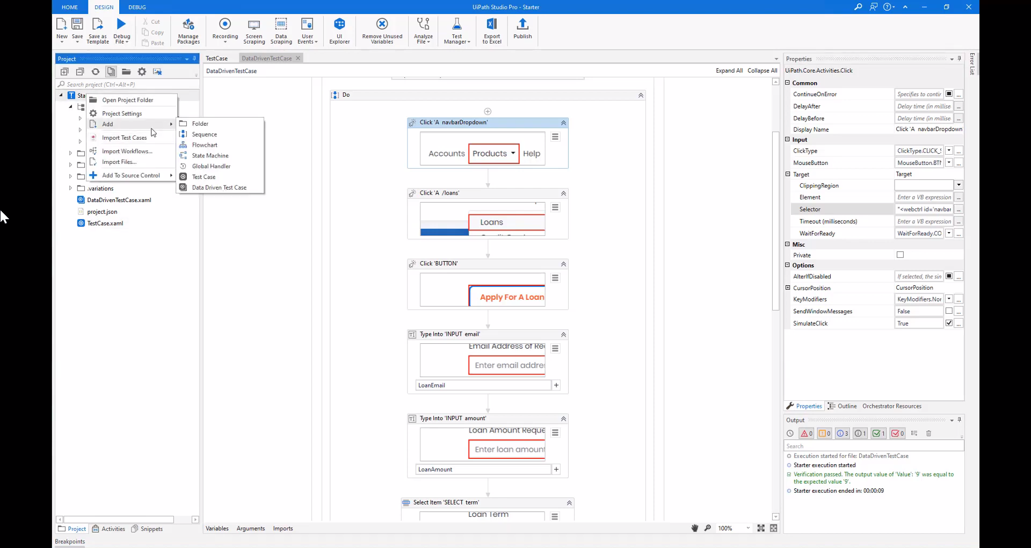
Two new workflow types are available in StudioPro:
Test Case - a template for one simple test automation. To create test case simply right click on Project pane > Add > Test Case.

Slide 21
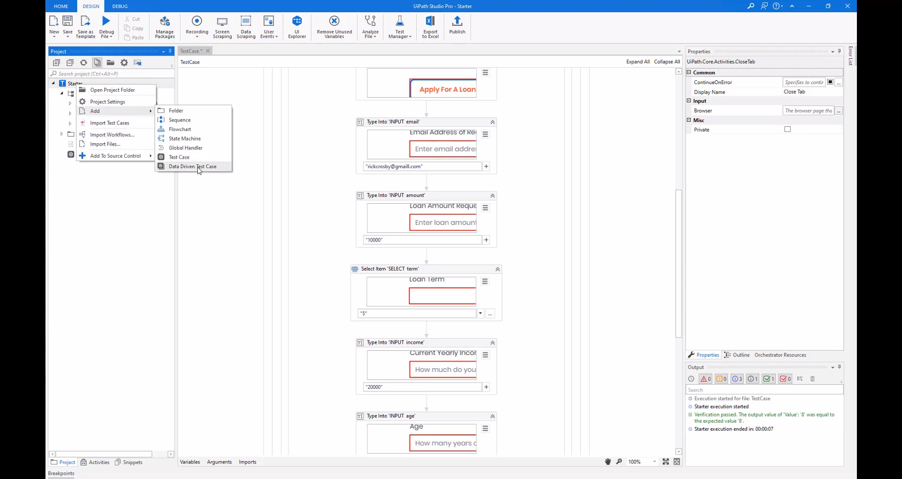
Data Driven Test Case - a template taking the input data from an Excel file. To create test case simply right click on Project pane > Add > Data Driven Test Case.

Slide 22
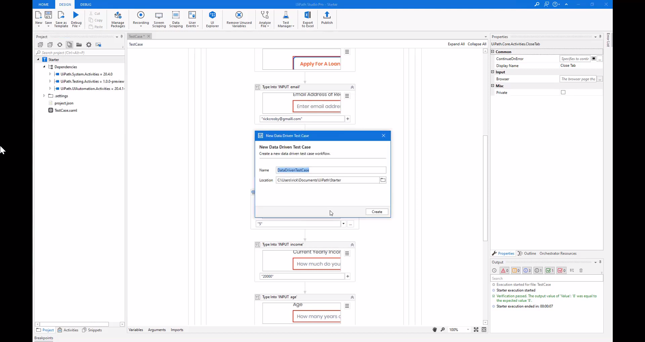
Provide name to the test case.

Slide 23
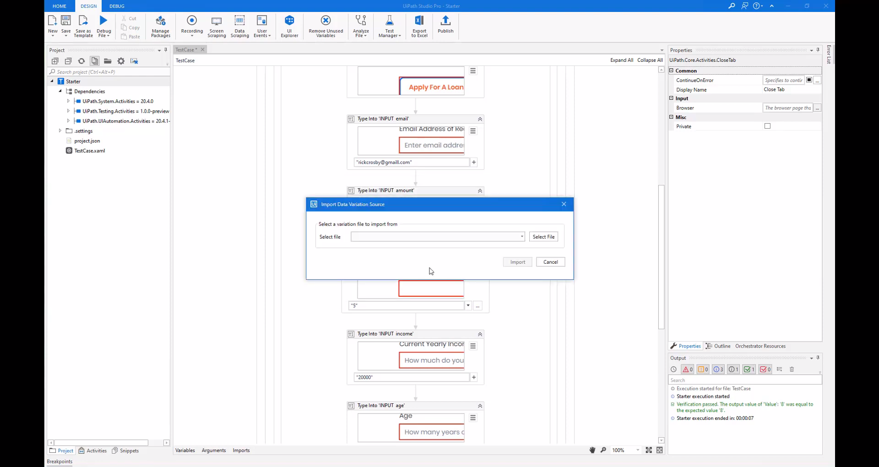
Select the input file (Excel file having input data).

Slide 24
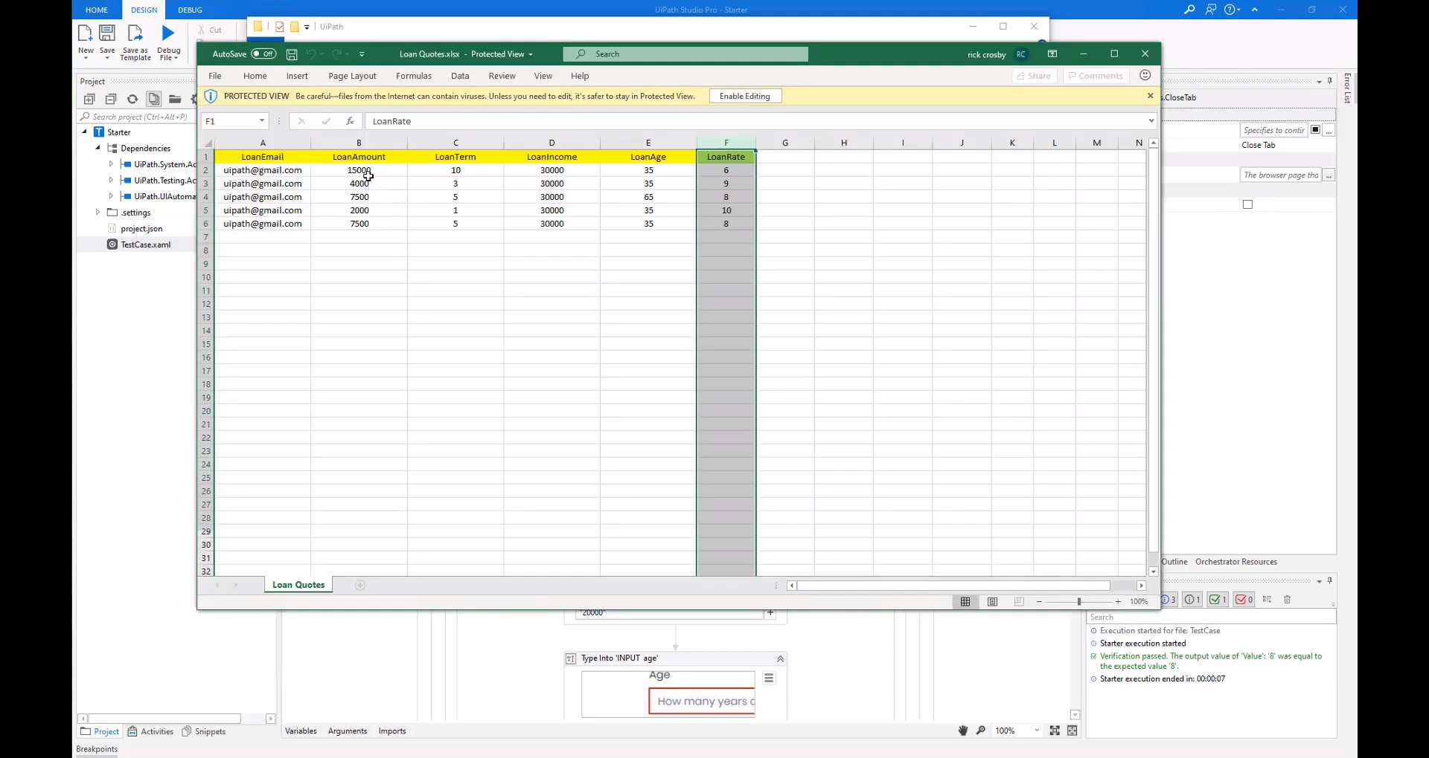
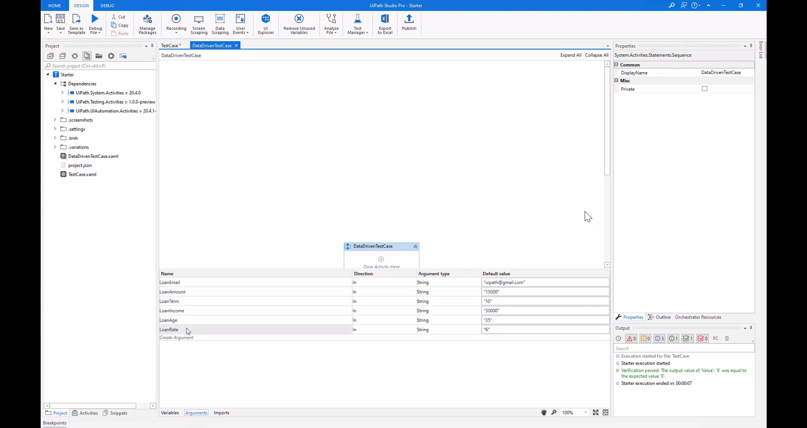
The columns headers from the input file are automatically created as arguments under the test case.

Slide 25
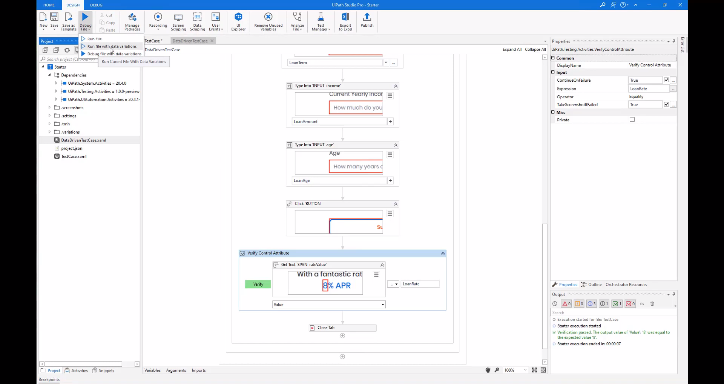
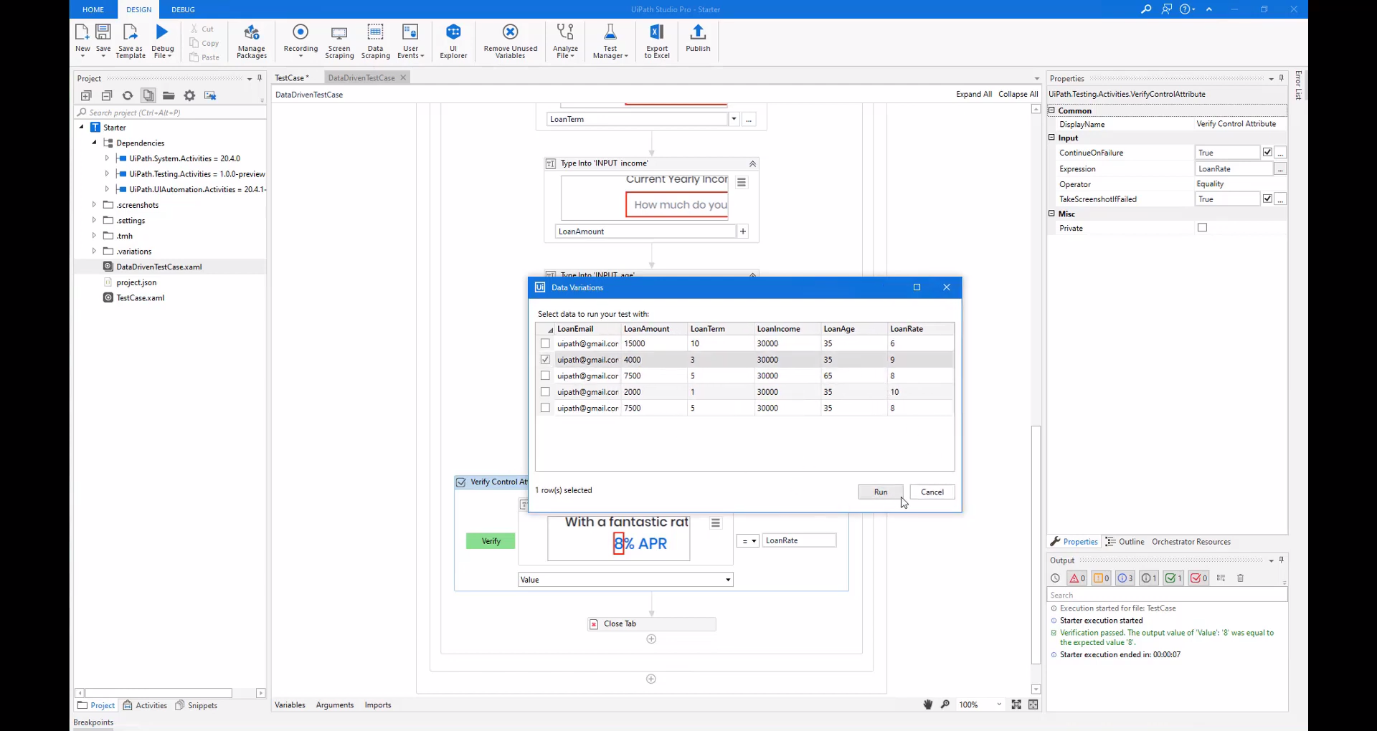
In order to execute data driven test case, a new option as Run file with data variations is provided. User is also given the option to select which input variation is needed for test case execution. Here a single row of input data can be selected or whole of the input data.

Slide 26
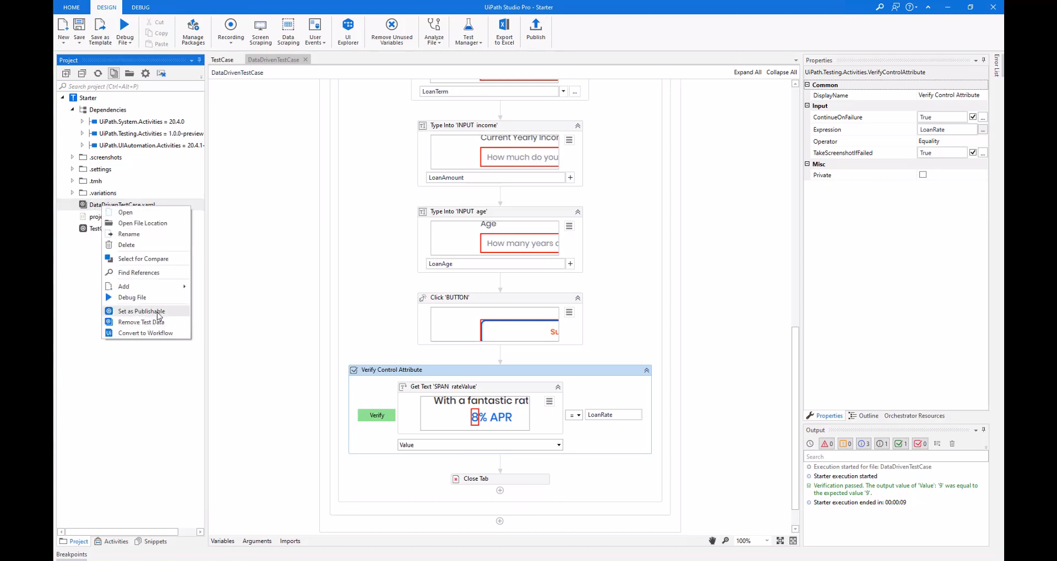
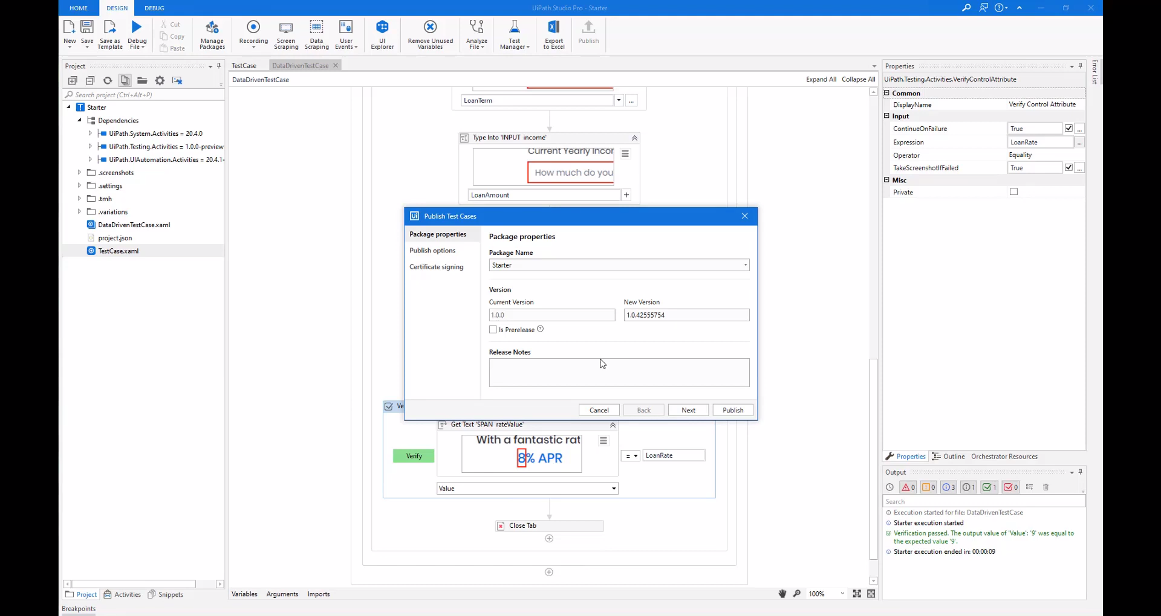
The test cases can then be published to orchestrator using Publish option but the selected test cases should be marked Set as Publishable.

Slide 27
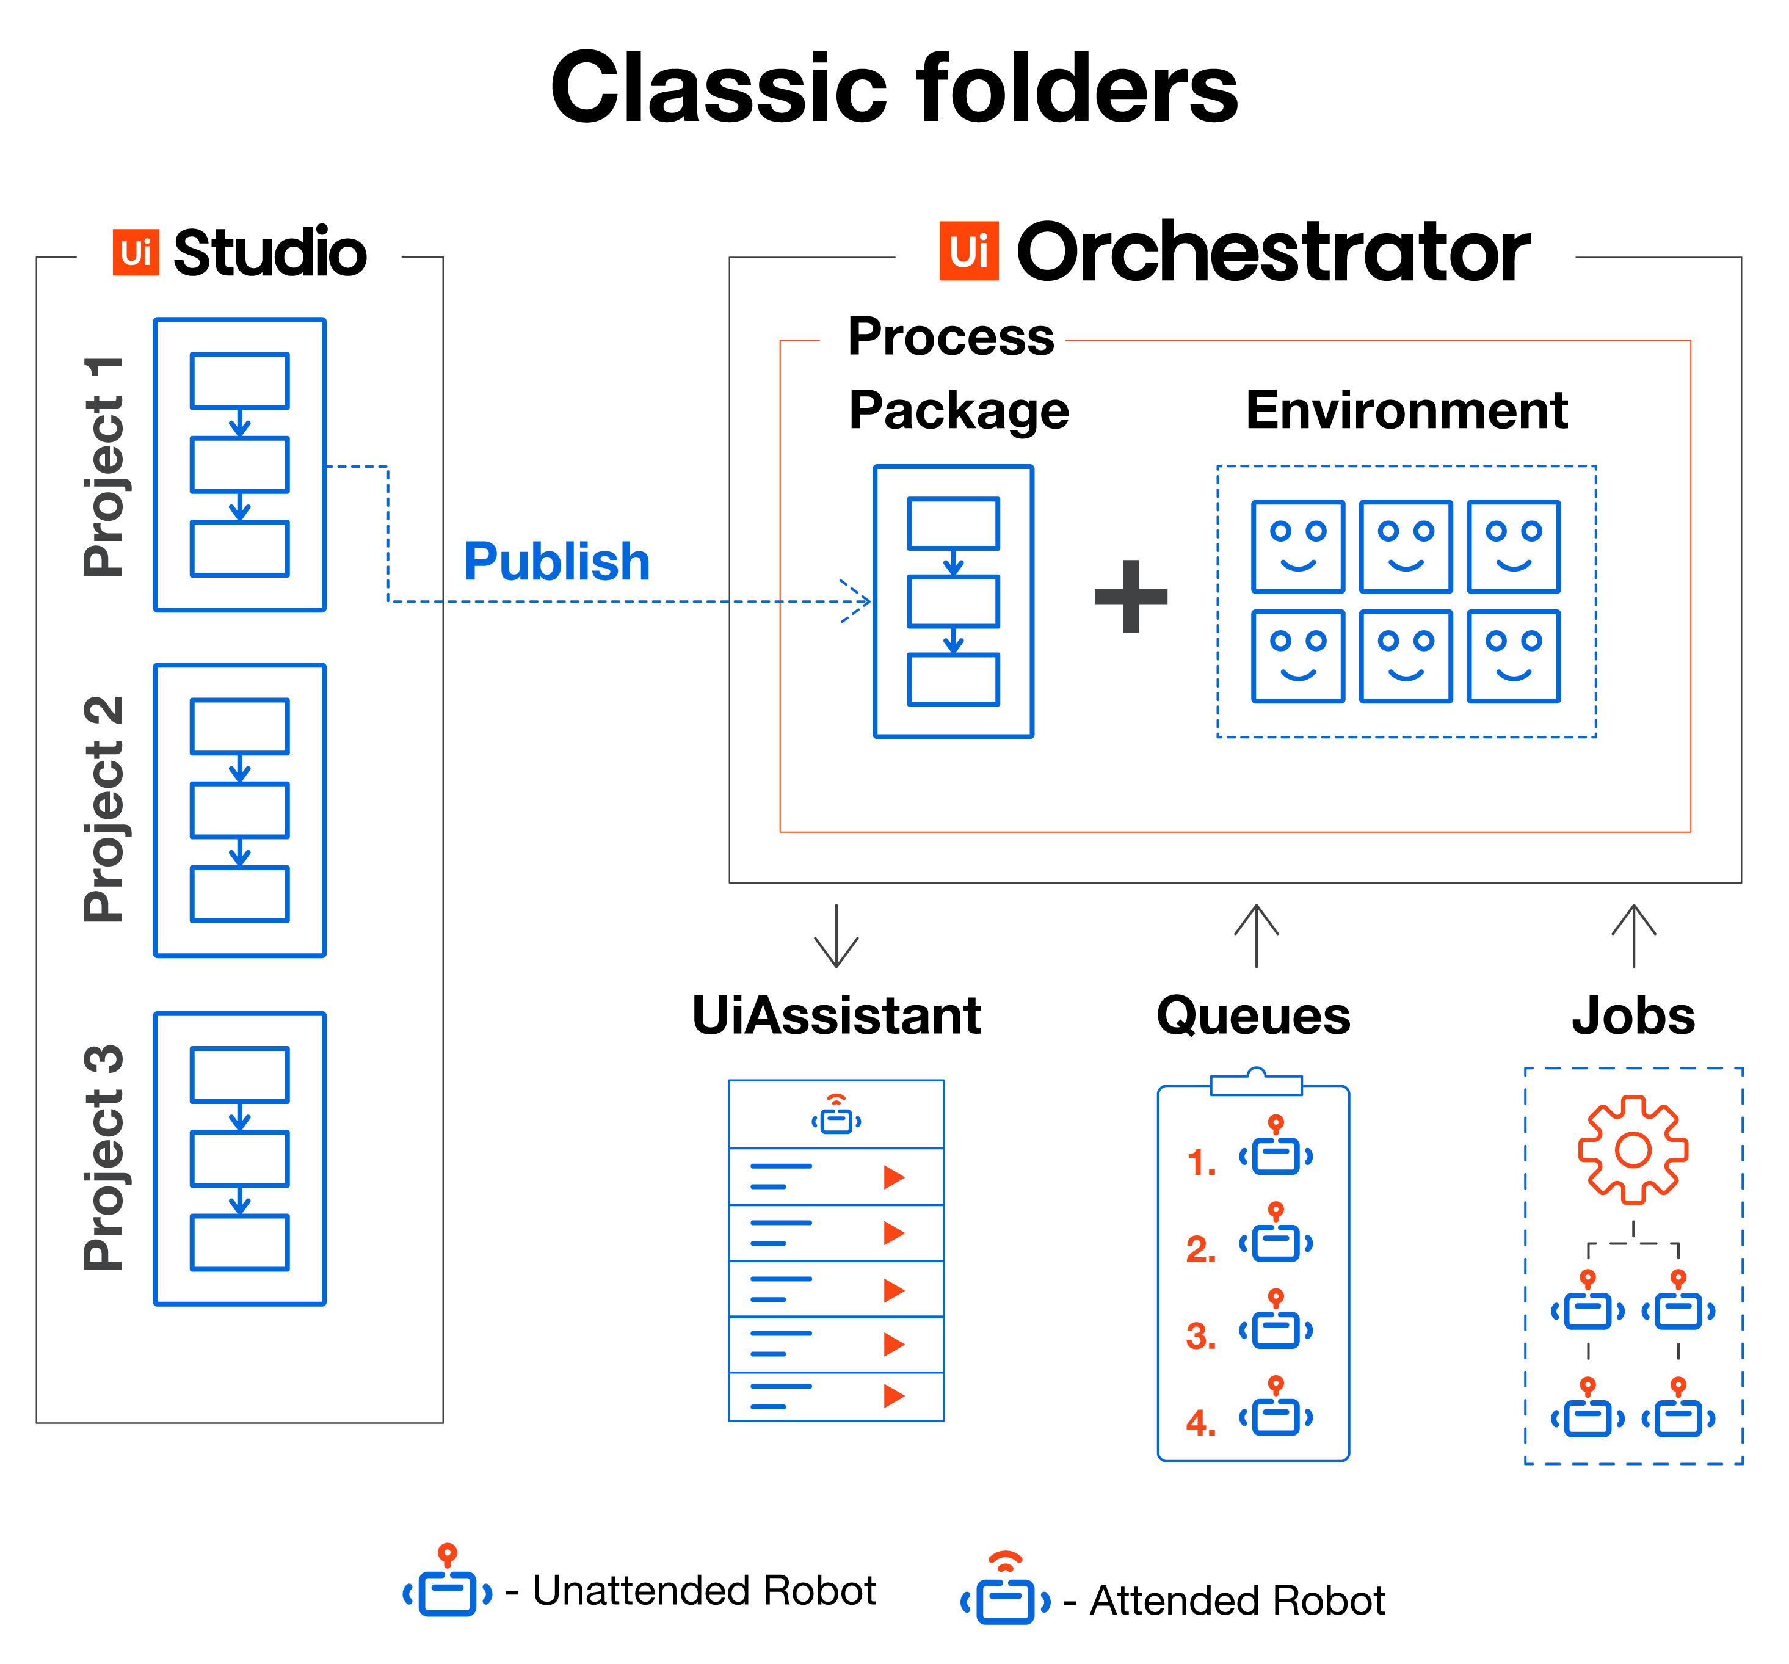
UiPath Orchestrator & Robots
There are two ways to set it up UiPath Studio Pro – Test Suite and Orchestrator Integration:
Through the Enterprise licensing model and an on-premises instance of UiPath Orchestrator, if company grants access to the UiPath Test Suite features;
Through the Community licensing model.
UiPath Robots are the agents that run the automations. UiPath Orchestrator is the component used to manage all the RPA assets: robots, licenses, published processes, credentials and execution queues.

Slide 28
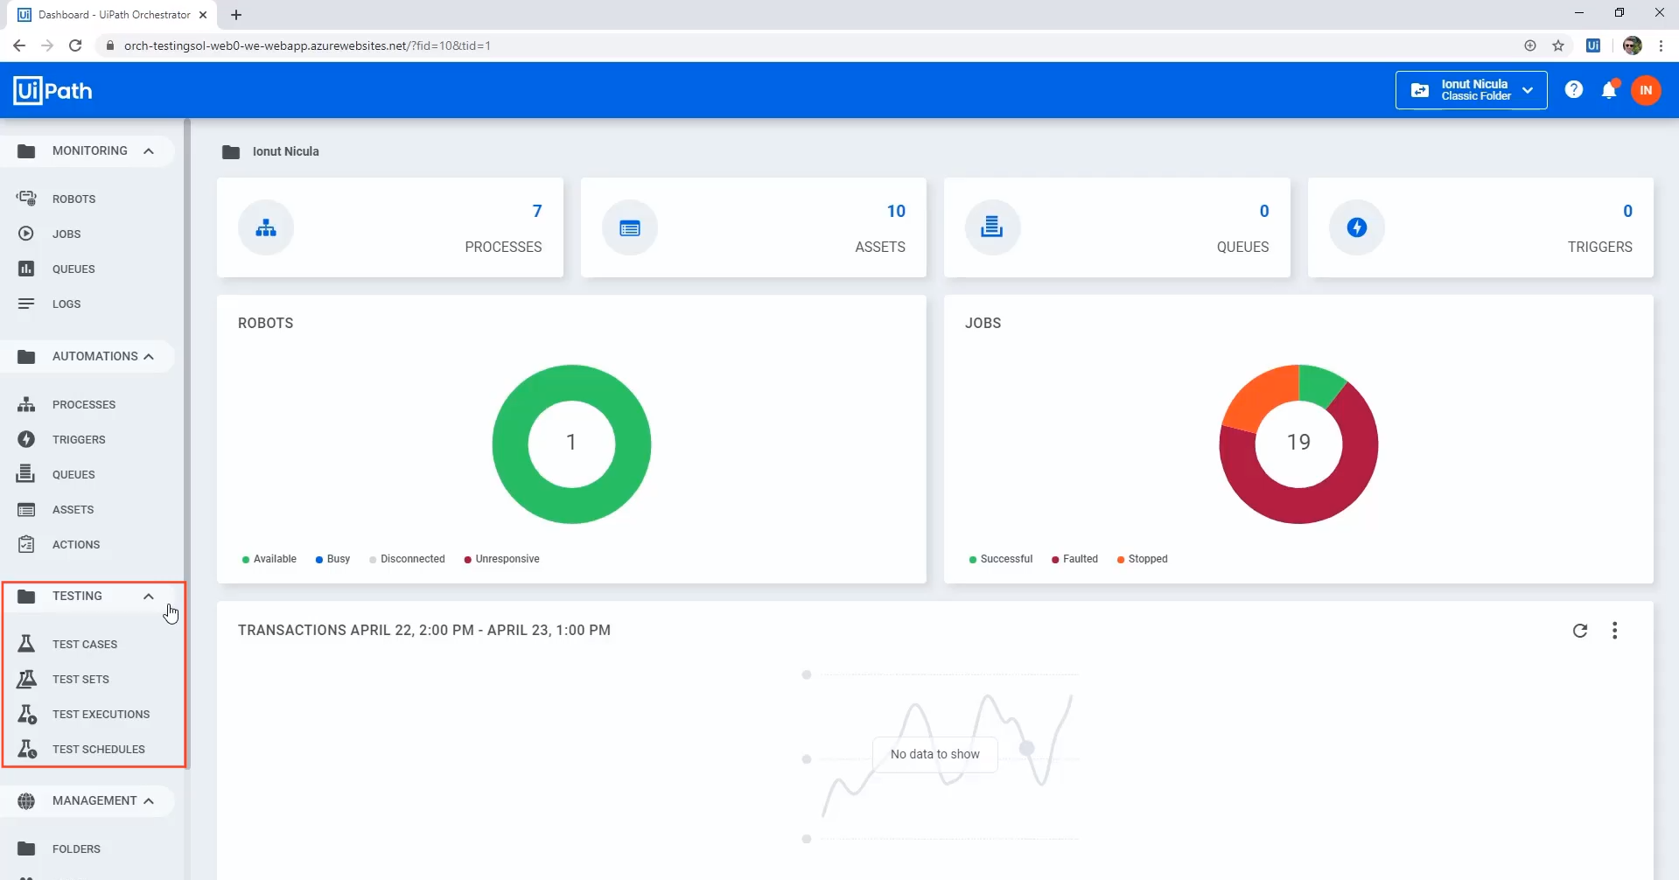
A new set of Testing components has been added under Orchestrator for managing, executing and scheduling test cases/suites.

Slide 29
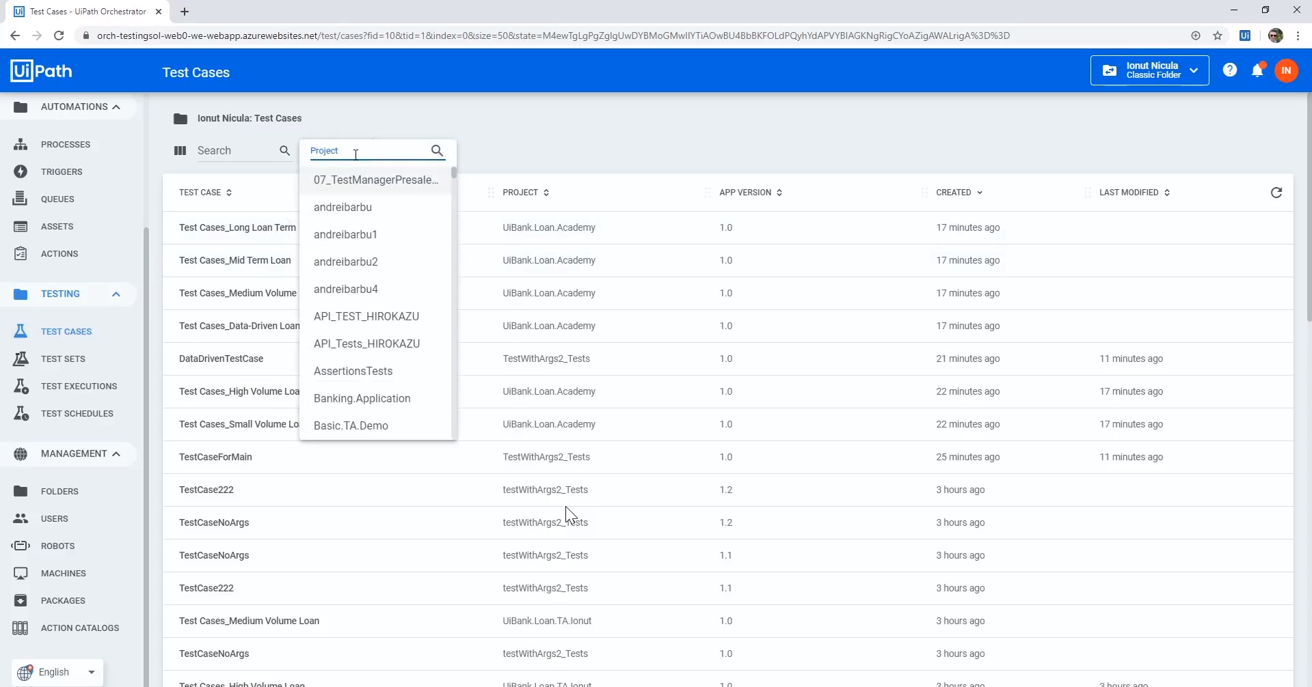
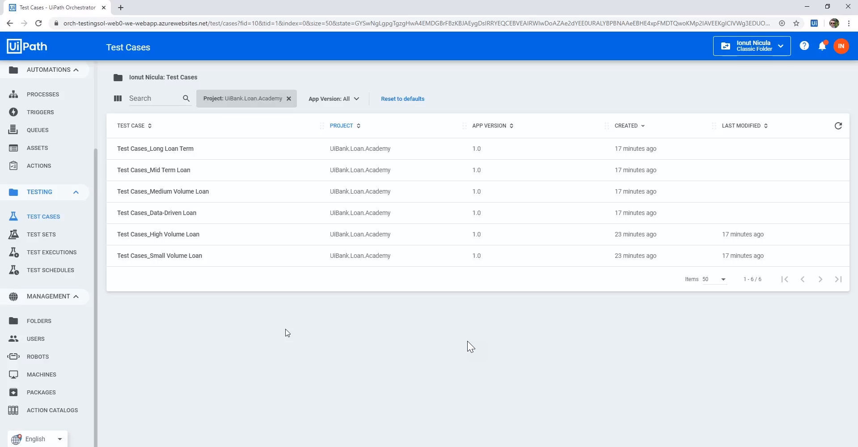
The test cases published from UiPath Studio Pro can be found under Orchestrator Testing > Test Case component. Project can also be searched by name provided while publishing project/test cases.

Slide 30
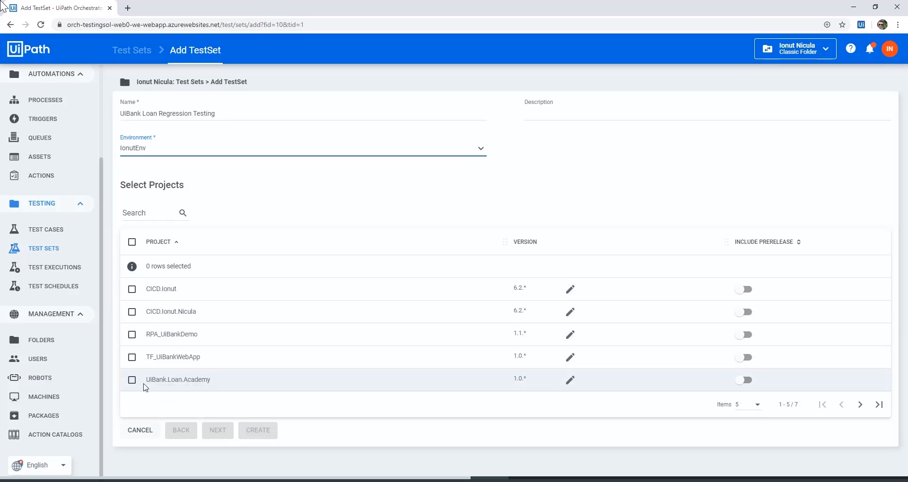
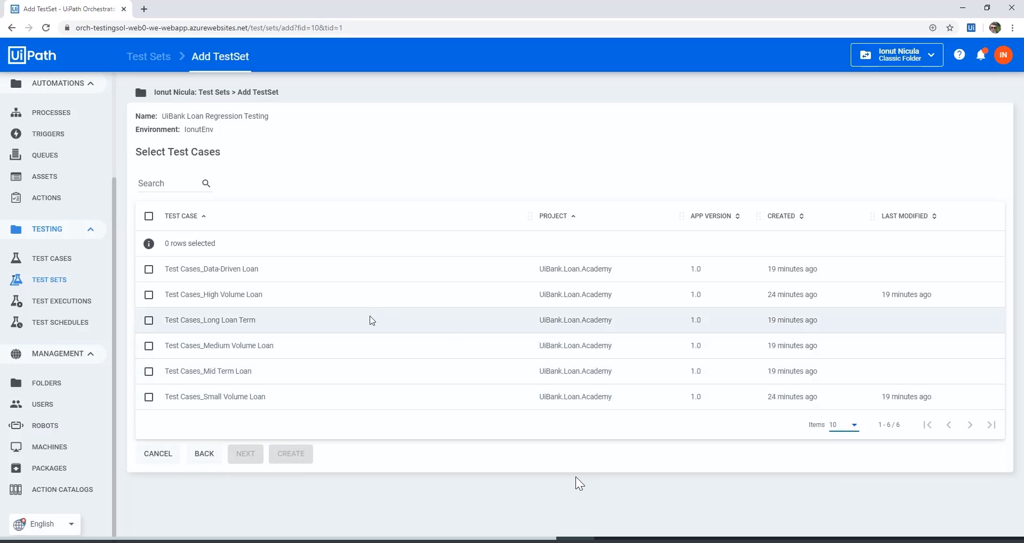
A new Test Set can be added by simply providing the Test Set Name, Environment, Project and Test Cases to be part of newly created Test Set.

Slide 31
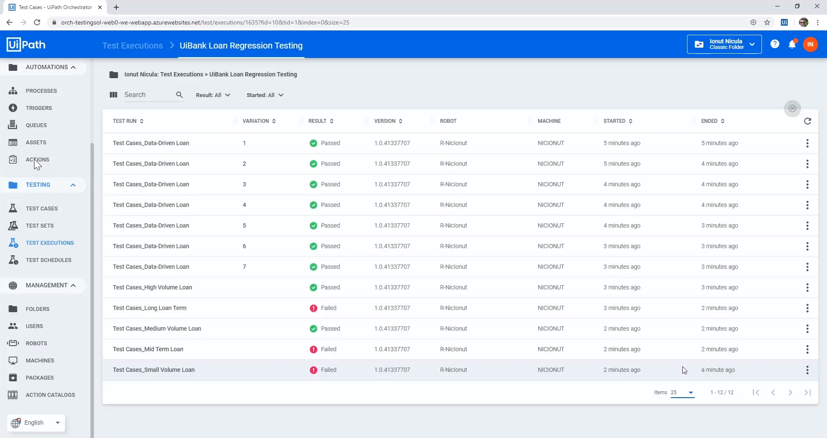
The result of test set (test cases) execution can be viewed under Test Execution component.

Slide 32
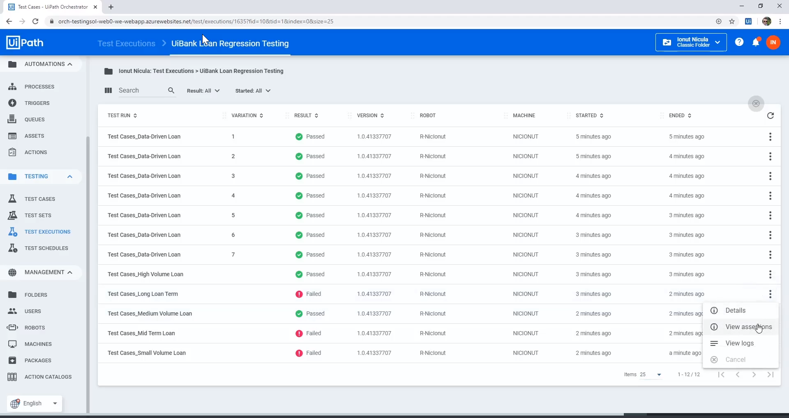
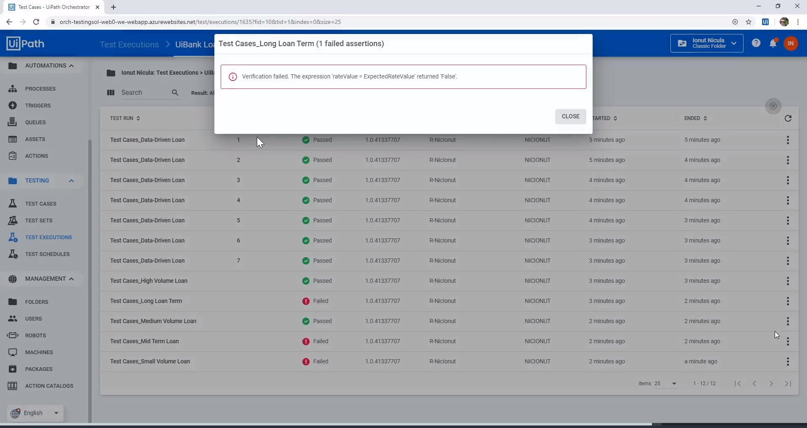
The reason of failure/pass for a particular test case can also be viewed by selecting View assertion.

Slide 33
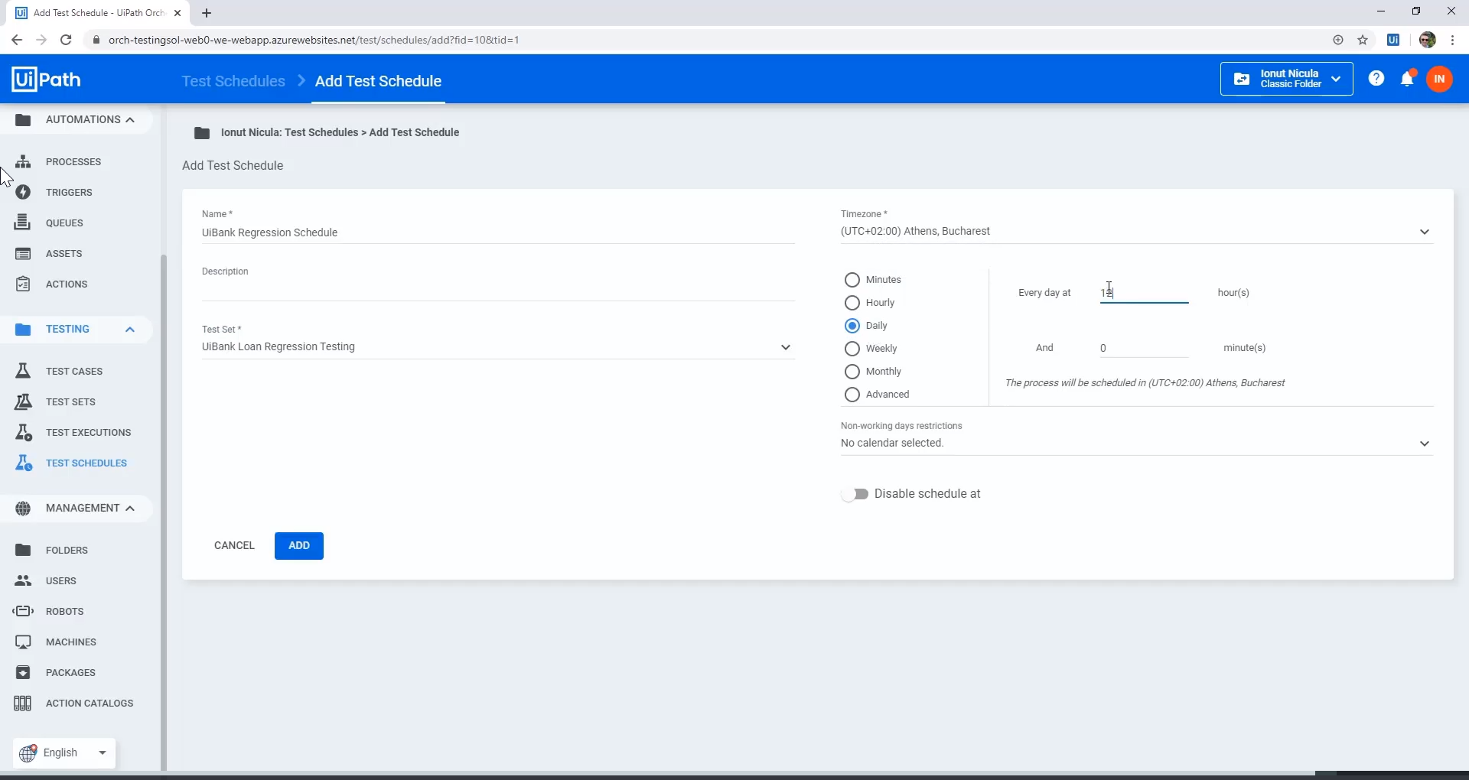
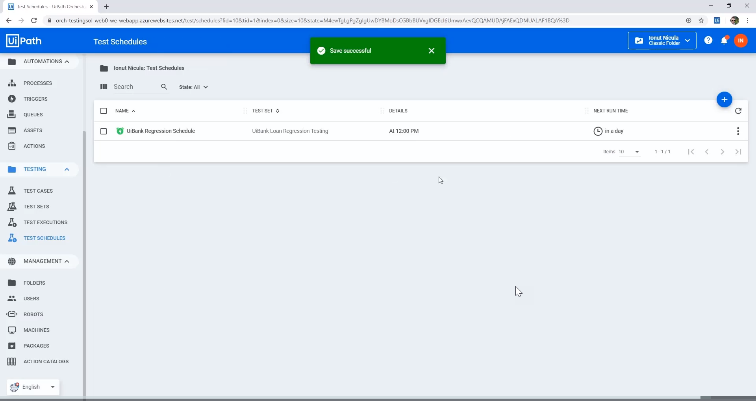
Test Set execution can be scheduled under Test Schedule component by providing Name of schedule , Test Set to execute and Time zone and Execution Interval(Weekly. Monthly etc.).

